Slide 1
Define Problem
Government agency does not have the resources to manually classify drone imagery for urban planning efforts
Will an automated classification system allow the government agency to produce the needed results given their limited resources?
How much classification accuracy will be lost by the automated system relative to manual classification?
Is there enough available data with the agency to produce a quality automated classifier?

Slide 2
Measurement Priorities
What to measure:
What amount of resources are saved through classification automation?
How will accuracy be measured?
What quantifiable features and values can be extracted from the images?
Total observations for each class in dataset
How to measure it:
Saved resources: Total government agency expenditures allocated to other projects
Accuracy: total correct predictions / total predictions
Unit of measures:
Border Length: meters
Area: squared meters
Color (red, green): RGB color model (0 - 255) value of individual pixels of feature
Rest of attributes are feature measurement ratios or unknown
Sub questions:
What feature classes have lower classification accuracy compared to others?
Is there a connection between incorrectly classified features?
Proximity to shadows, coarseness of image, partially photographed features

Slide 3
Data Collection
Agency with several thousand drone high resolution images, 650 delivered to Redhorse
From these images, 21 features at each of 7 levels of coarseness can be extracted:
Border Index (shape variable)
Area in m² (size variable)
Roundness (shape variable)
Brightness (spectral variable)
Shape Index (shape variable)
Compactness (shape variable)
Mean and SD Green (spectral variable)
Mean and SD Red (spectral variable)
Mean and SD Near Infrared (spectral variable)
Length/Width (shape variable)
Rectangularity (shape variable)
Border Length (shape variable)
3 Gray-Level Co-occurrence attributes (texture variables)
Density (shape variable)
Asymmetry (shape variable)
NDVI: Normalized Difference Vegetation Index (spectral variable)
Business Rules:
All predictor data is numeric and unitless, no string data except for class
All fields must be complete
Each column has single, standard unit of measurement
Complete data from each image is collected by single team member to prevent duplicate entries
Images must be collected in spring/summer to capture green vegetation coloring and same time of day for shadow standardization
Data Storage and Updating:
Excel can be used for collaborative data entry and storing raw data
If the available data becomes large, MongoDB (NoSQL database) used for storage and querying

Slide 4
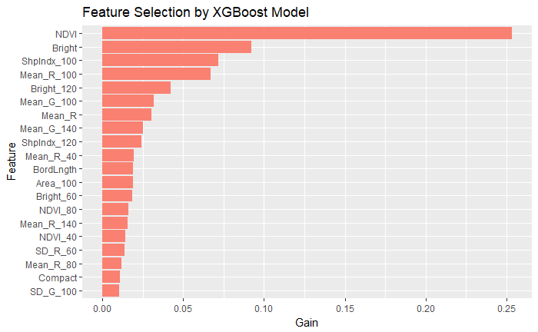
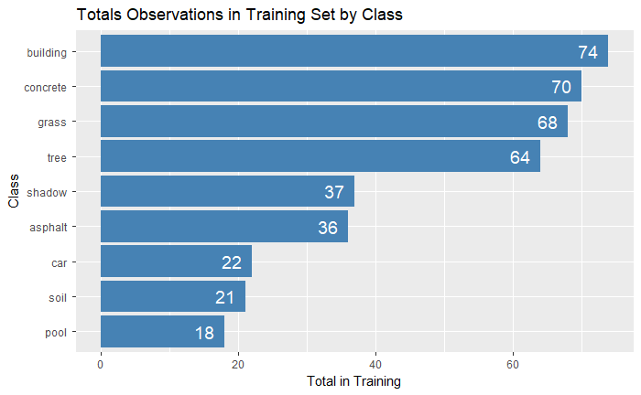
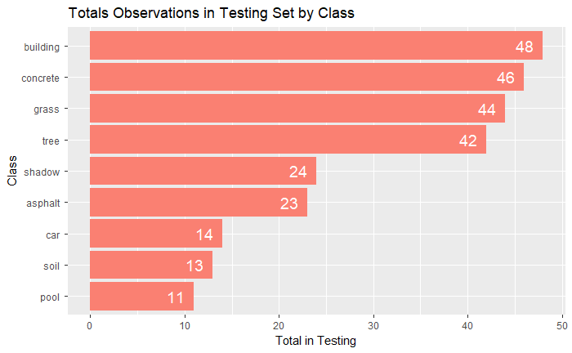
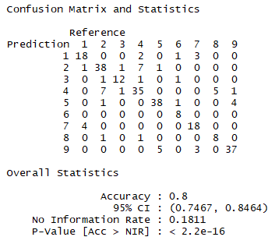
Data Analysis
Train/test split on 60:40 ratio (410 training, 265 testing)
All data is numeric with no missing values
Normalize and standardize data to keep on same scale [0,1] and in normal distribution
Feature selection with XGBoost tree model
Elastic Net, kNN, and Multinomial Logistic Regression models run and used for prediction
Class | Num_Val
asphalt | 1
building | 2
car | 3
concrete | 4
grass | 5
pool | 6
shadow | 7
soil | 8
tree | 9
Multinomial Logistic Regression Model Results

Slide 5
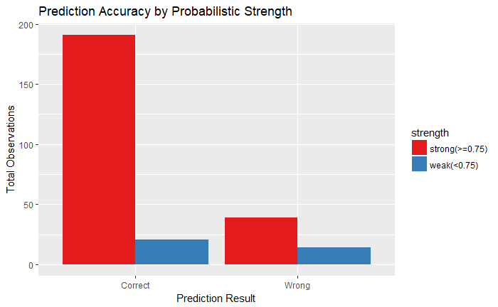
Interpreting Results
Tree and grass had most accurate prediction rate(result of NDVI feature), soil had worst (62%)
Building/soil vs. concrete were most difficult to differentiate
Multinomial Logistic Regression returns overall prediction accuracy of 80%
Uneven distribution of class and high number of classes results in inadequate amount of training and testing data for some levels of class
Simple model can predict class with fair amount of accuracy, more complex models will save significant resources for government agency
More training and testing data and a more uniform distribution of class is required to improve model performance

